Slide 1
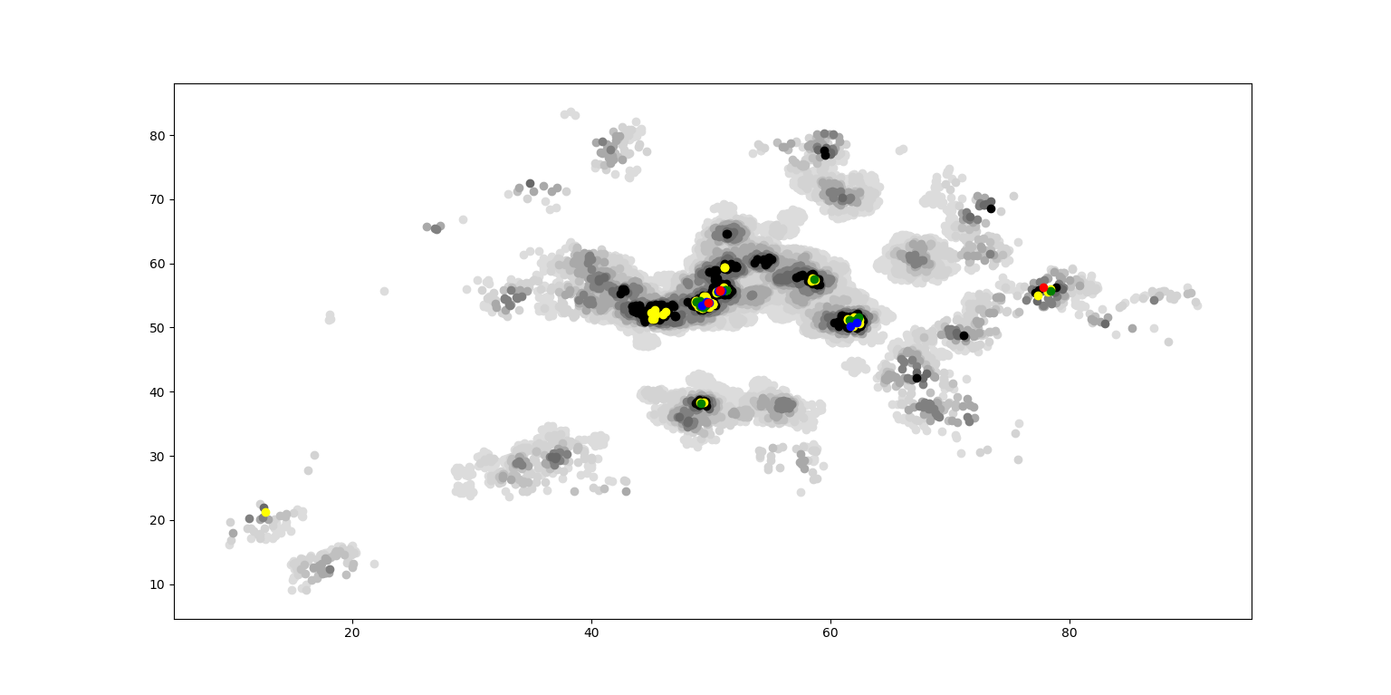
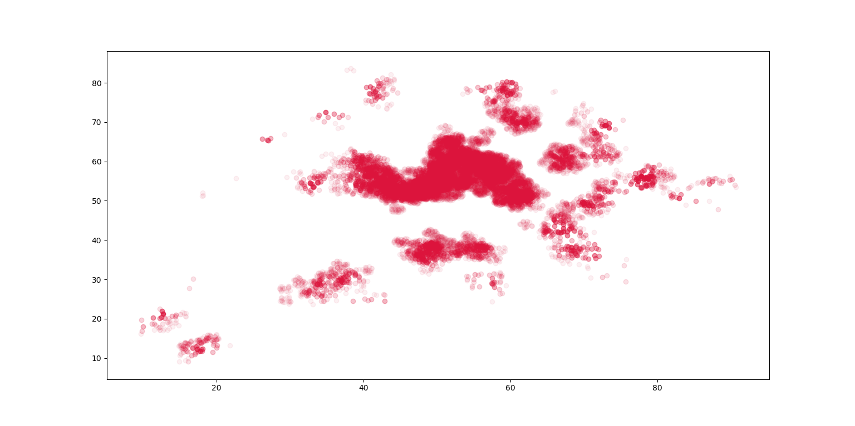
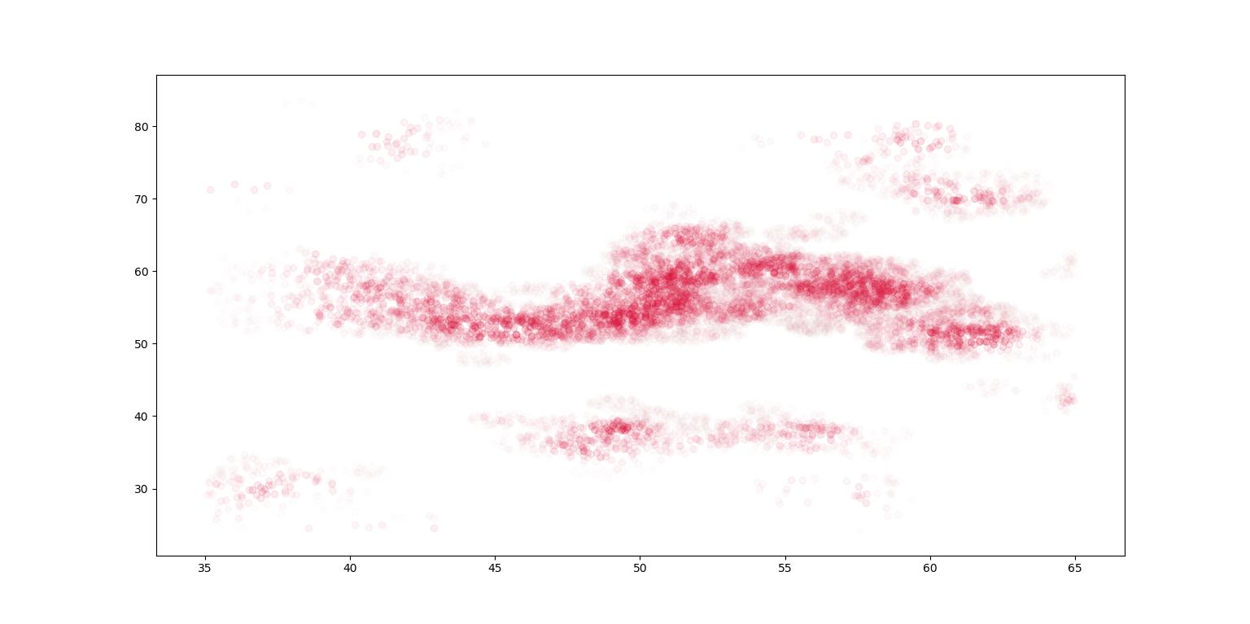
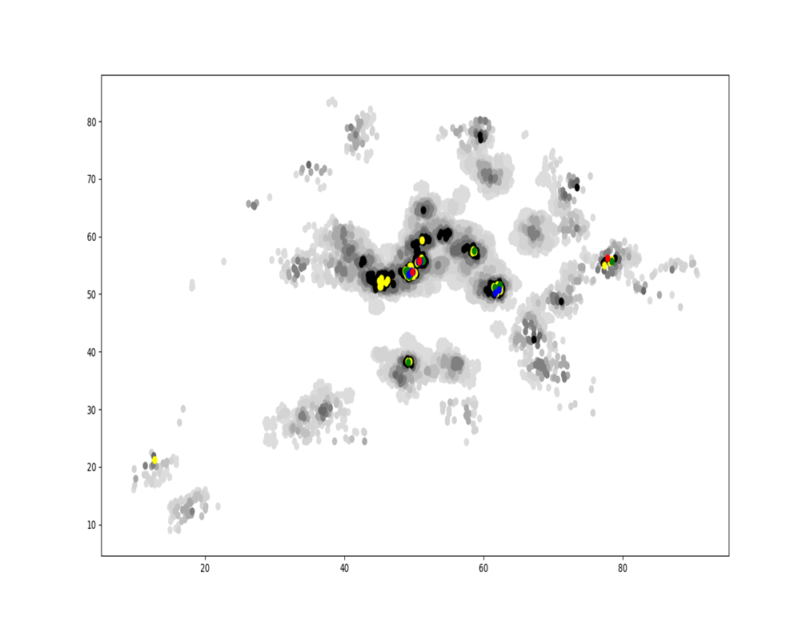
VE414 • Bayesian Analysis
VE414 Project：
Finding Trees in Forbidden Forest Using Hidden Markov Model
Team Members: Wenhao Guo, Jiazhen Ji, Jing Dong
Faculty Advisor: Prof. Jing Liu
Problem Statement
In the Forbidden Forrest of Hogwarts, there is a kind of magic tree, known as Jiuling, not only it is always invisible but it has no physical form. This tree can produce a kind of fruit, naming Tayes, that is detectable. From each people in the forest, we have the exact data for each location the number of Tayes close by (less 1 meter away) on the ground and the number of Tayes no far way (less 3 meters away) on the ground from the person. The main task is to find the number of Jiuling in the Forbidden Forrest, and the distribution of Jiuling in the sense of where they are.
Data Analysis
To help us observe data provided, we utilize python to plot graphs which are able to show density of Tayes. In Figure 1, we plot every point where Tayes exits in a circle with radius of 1 m. Different colors represent different number of Tayes. And color representing a greater number of Tayes will cover color representing a smaller number of Tayes.
Fig. 1 Density of Tayes
Another graph uses transparency to express the number of Tayes near a point. As we can see in Figure 2, because of too many Tayes are founded in the center of graph, it is not clear for us to observe it. So we
Fig. 2 Density of Tayes
plot another graph to focus on the center part.
Fig. 3 Center Part
Modeling and Simulation
Method 1: HMM
The first method concerns the structure of Hidden Markov Model. Basically, the method have two parts. The first part is using the method of Hidden Markov Model to discover the distribution of Tayes. The actual distribution of Tayes is considered as hidden layers and the number of Tayes detected in each location is the observable layer. Using Hidden Markov Model, we can estimate the distribution and the number of Tayes.
The second part is estimate the distribution and number of Jiuling using the result of the first part. We can suppose a threshold Tayes and a area of trees. As long as the density in a certain area is larger than the threshold, we can assume that there is a tree in that area.
Method 2: Logistic Regression
Valid
Conclusion
Photoacoustic and ultrasound imaging techniques can be used for detecting osseous and vascular structures simultaneously. The key to achieve this goal is to set up the dual modality system. And also, the accuracy and speed of the detection is very important to form the images.
Acknowledgement
Sponsor: Shawn Ma from Covidien
Shane Johnson, Sung-Liang Chen and Huan Qi from UM-SJTU Joint Institute
Hongkun Lai and Xunjie Cai from UM-SJTU Joint Institute
Reference
[1]http://labs.seas.wustl.edu/bme/Wang/index.html

